Slide 1
WORM FORMULA
W = R x M
Used to determine the LEFT or RIGHT lateral shift from the known point to the target in meters.
“W” is the LEFT or RIGHT shift that is transmitted to the FDC.
“R” is the range from the Observer to the known point, divided by one thousand.
“M” is the difference in MILS from the known point direction and the target direction.

Slide 2
TARGET
DIR 1000
KN PT 1
DIR 1100
DIS 700
L 70
W = R X M
L70 =
.7 x
100
OBSERVER
Determine the lateral shift….

Slide 3
The Six Elements
Observer Identification.
Warning Order.
Target Location.
Target Description.
Method of Engagement.
Method of Fire and Control.
First Transmission
Second Transmission
Third Transmission

Slide 4
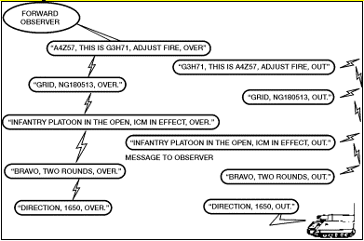
The Whole Process

